Slide 1
ANN
Artificial Neural Network – Part 2
Pankaj

Slide 2
ANN – ARITIFICAL NEURAL NETWORK
What will we learn in this section :
The Neuron
The Activation Function
How do Neural Networks work ?
How do Neural Networks learn ?
Gradient Descent
Stochastic Gradient Descent
Backpropagation
DL

Slide 3
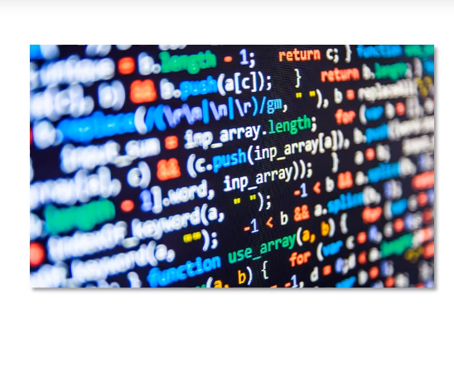
ANN – How do Neural Networks learn
The ANN code we have the written

Slide 4
ANN – How do Neural Networks learn
The code will mimic the Neural Network in Brain

Slide 5
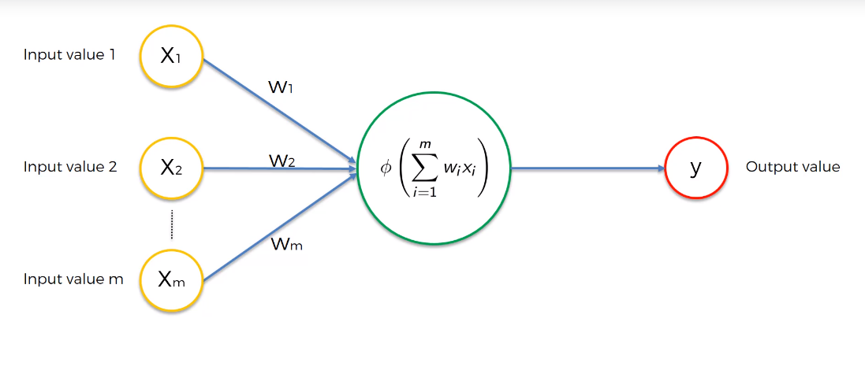
ANN – How do Neural Networks learn
Single Layer Feed Forward Neural Network & It is also called as Perceptron

Slide 6
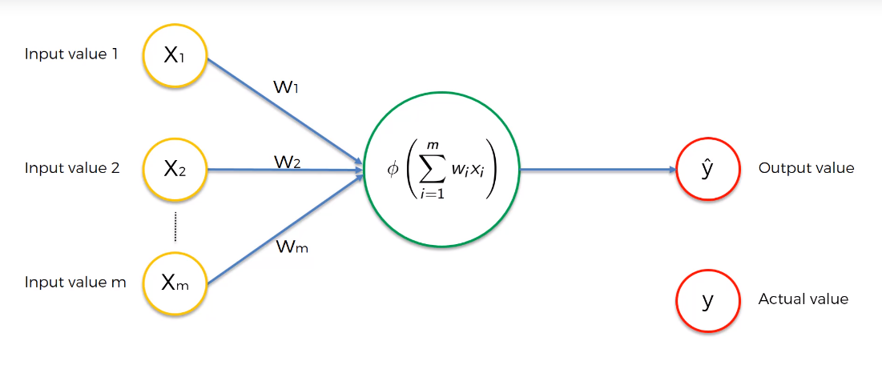
ANN – How do Neural Networks learn
The Actual Value is represented as y, Predicted value as y hat

Slide 7
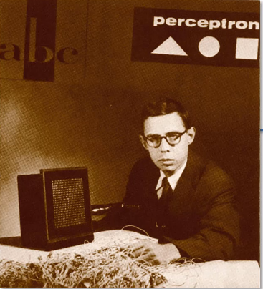
ANN – How do Neural Networks learn
The Perceptron was first invented by 1957 by Frank Rosenblat

Slide 8
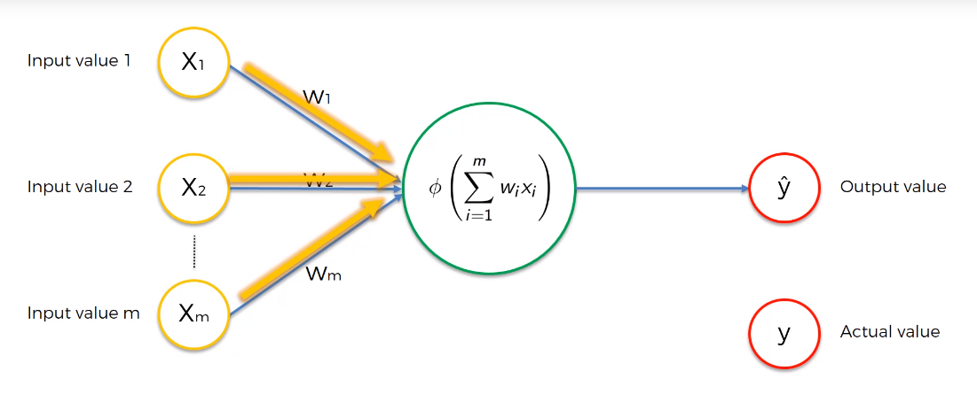
ANN – How do Neural Networks learn
Values are Feed to Neuron

Slide 9
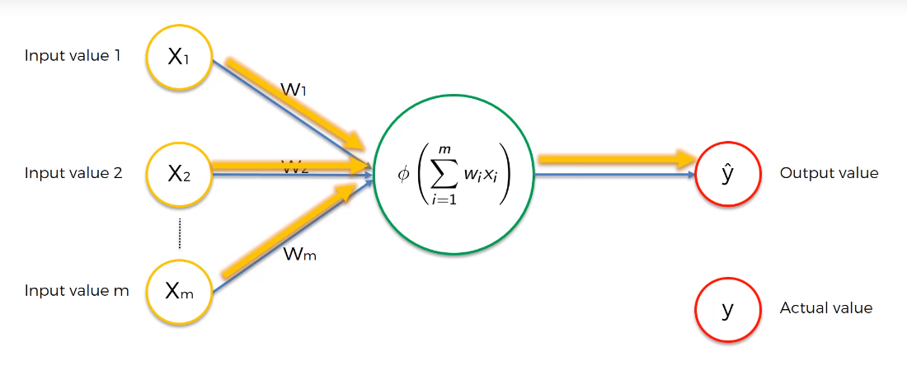
ANN – How do Neural Networks learn
DL

Slide 10
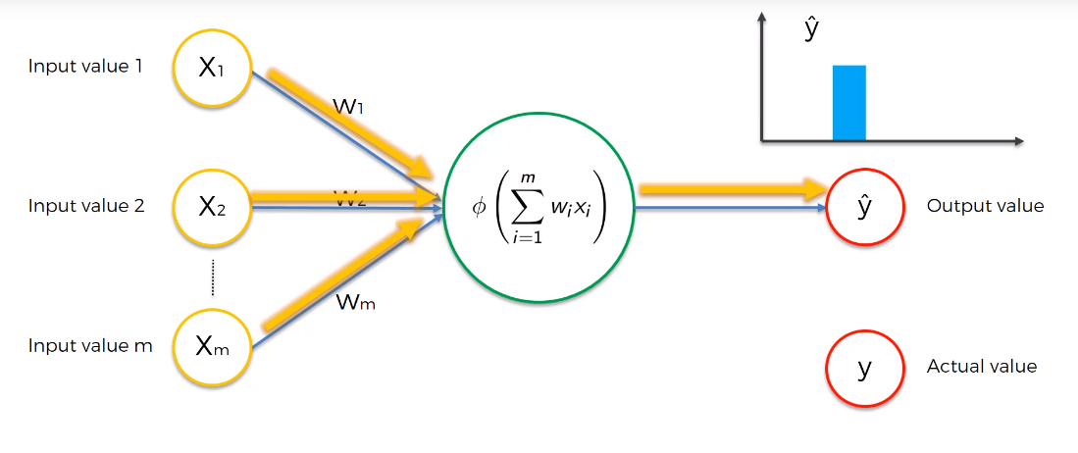
ANN – How do Neural Networks learn
DL

Slide 11
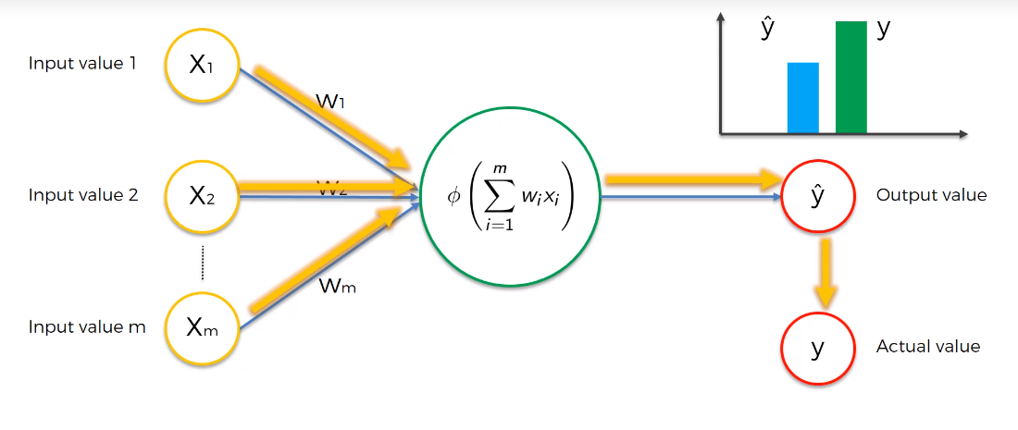
ANN – How do Neural Networks learn
DL

Slide 12
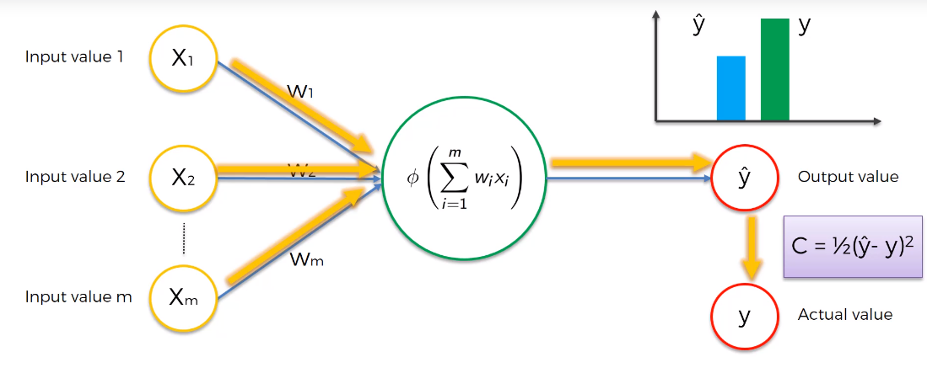
ANN – How do Neural Networks learn
DL

Slide 13
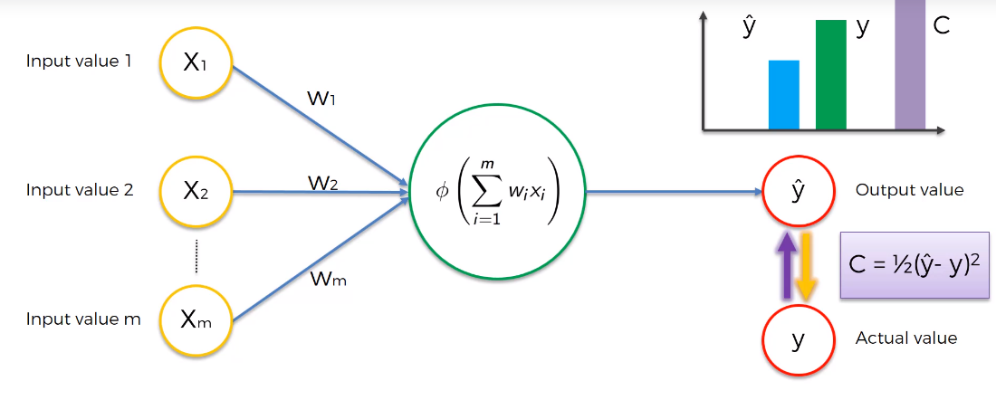
ANN – How do Neural Networks learn
DL

Slide 14
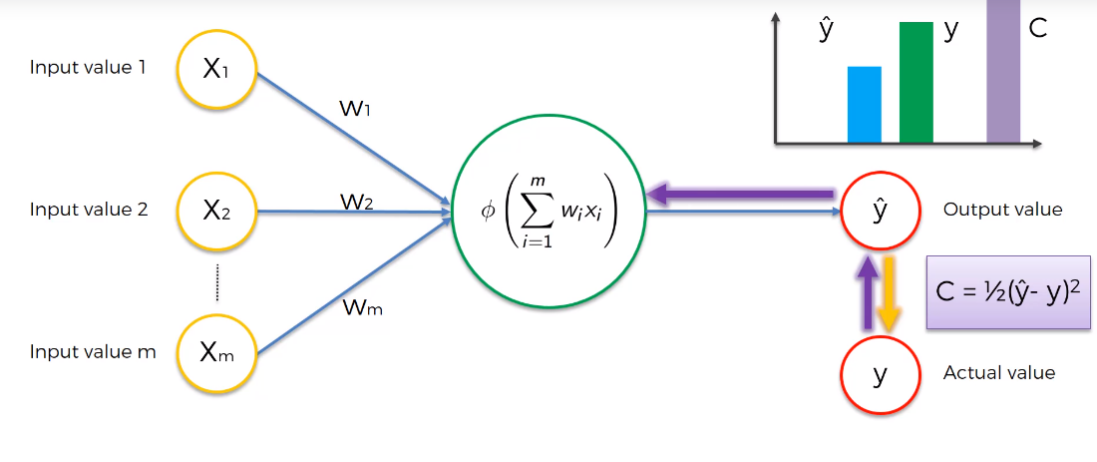
ANN – How do Neural Networks learn
DL

Slide 15
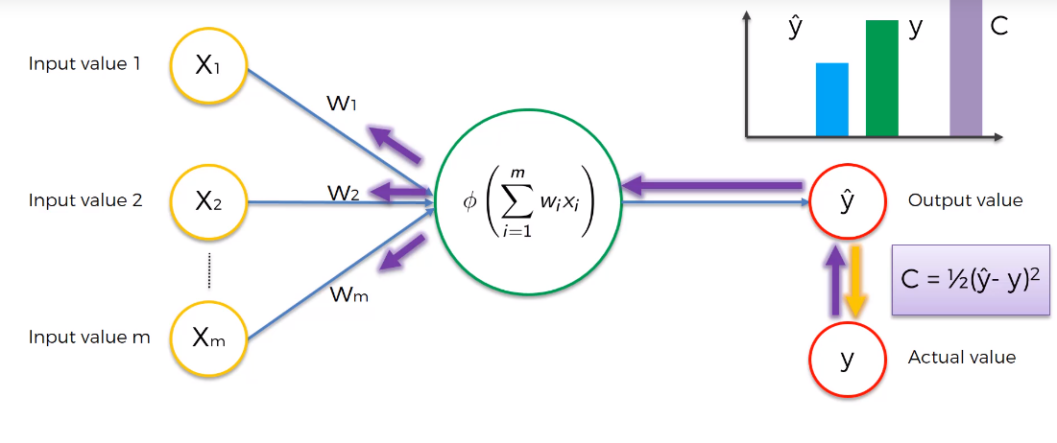
ANN – How do Neural Networks learn
DL

Slide 16
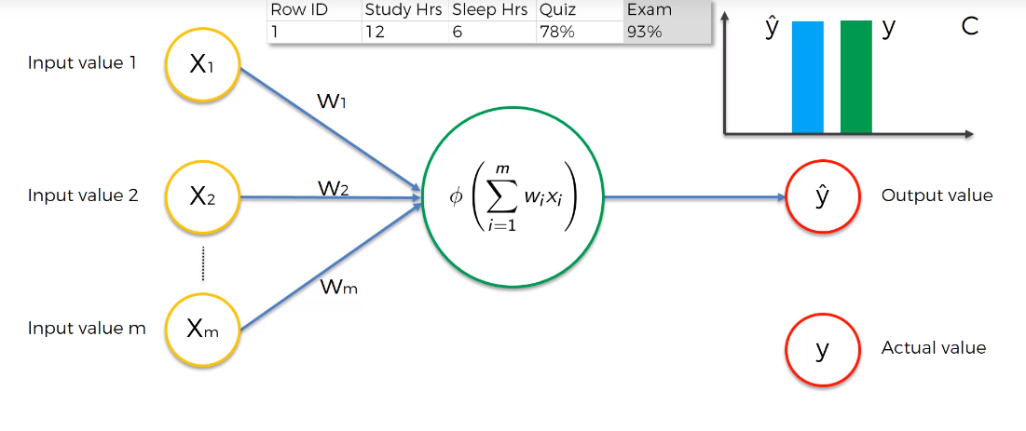
ANN – How do Neural Networks learn
DL

Slide 17
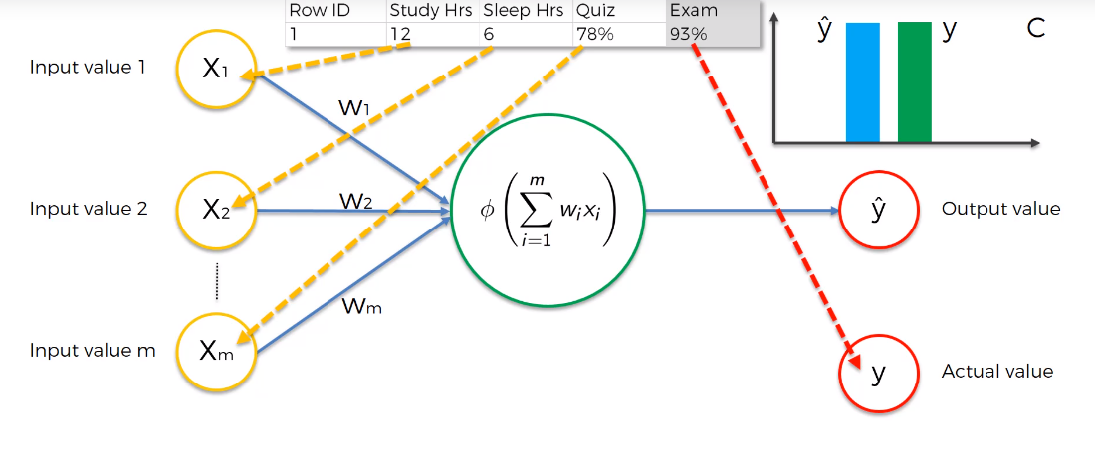
ANN – How do Neural Networks learn
DL

Slide 18
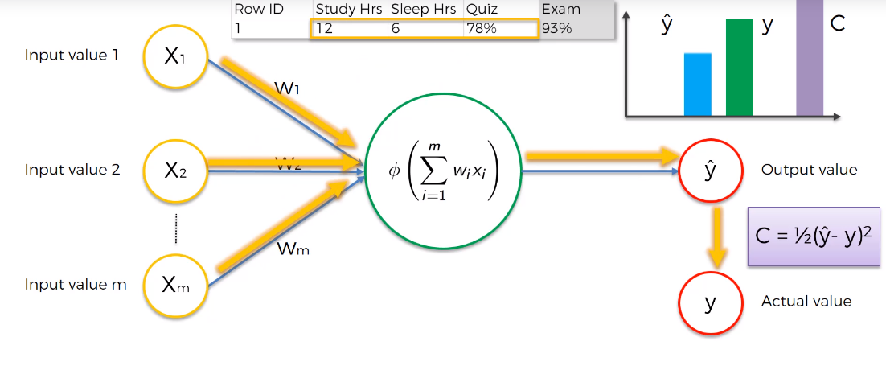
ANN – How do Neural Networks learn
DL

Slide 19
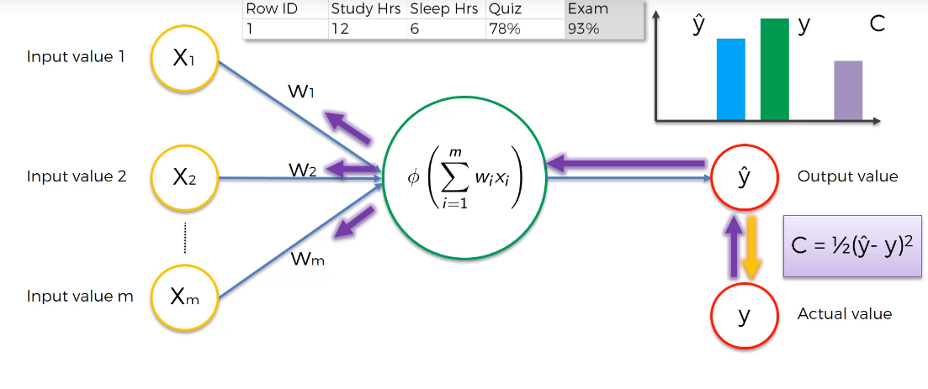
ANN – How do Neural Networks learn
DL

Slide 20
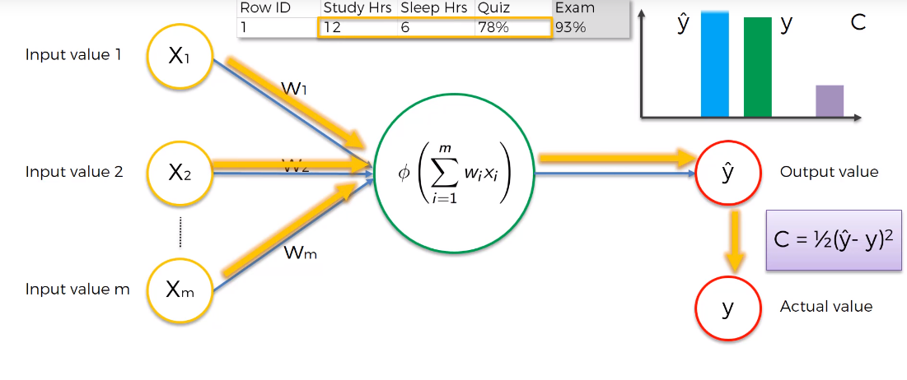
ANN – How do Neural Networks learn
DL

Slide 21
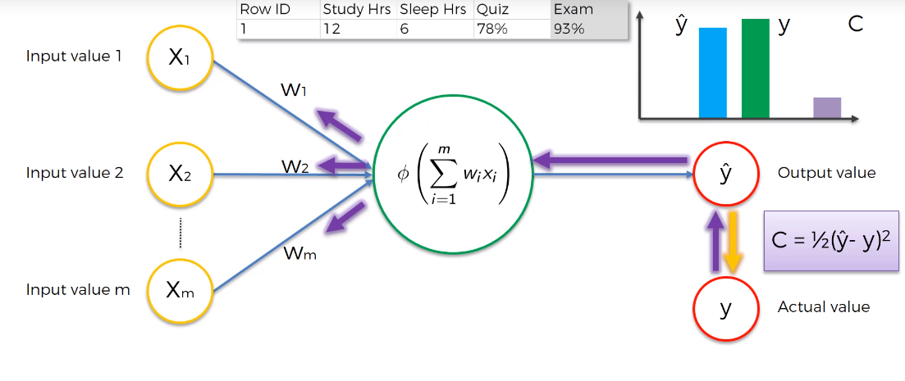
ANN – How do Neural Networks learn
DL

Slide 22
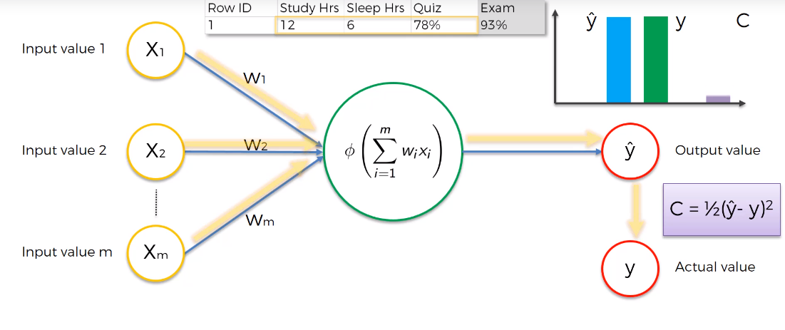
ANN – How do Neural Networks learn
DL

Slide 23
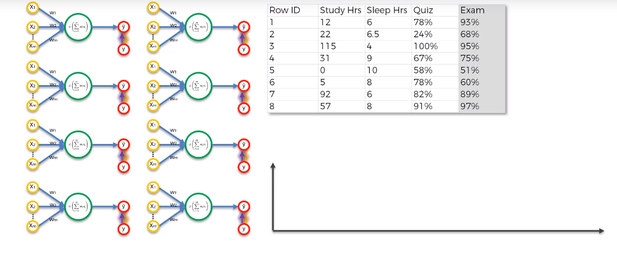
ANN – How do Neural Networks learn
Example: when we have multiple row

Slide 24
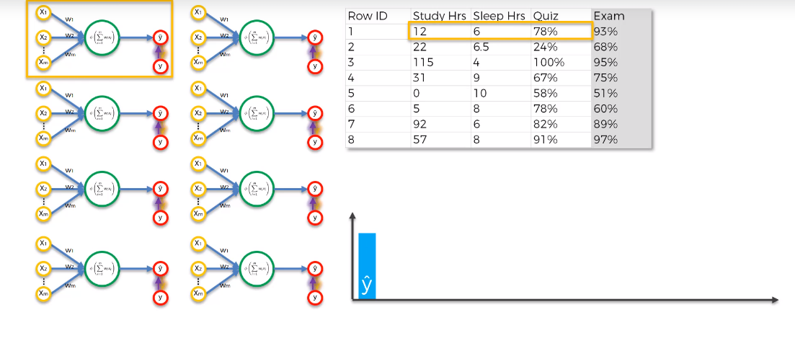
ANN – How do Neural Networks learn
DL

Slide 25
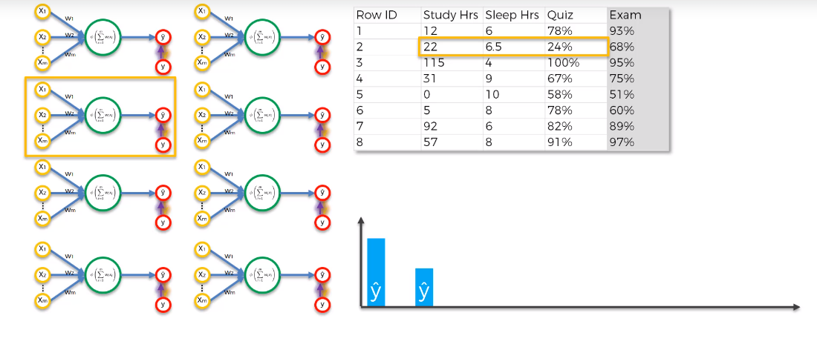
ANN – How do Neural Networks learn
DL

Slide 26
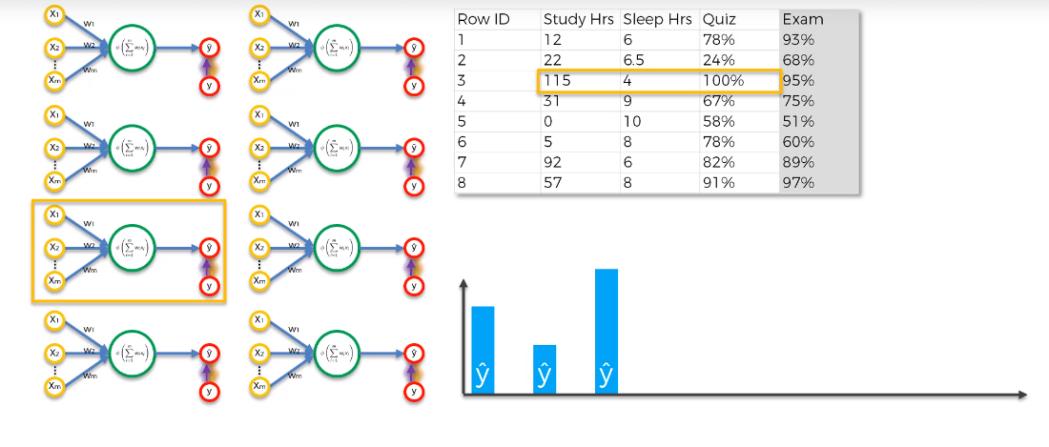
ANN – How do Neural Networks learn
DL

Slide 27
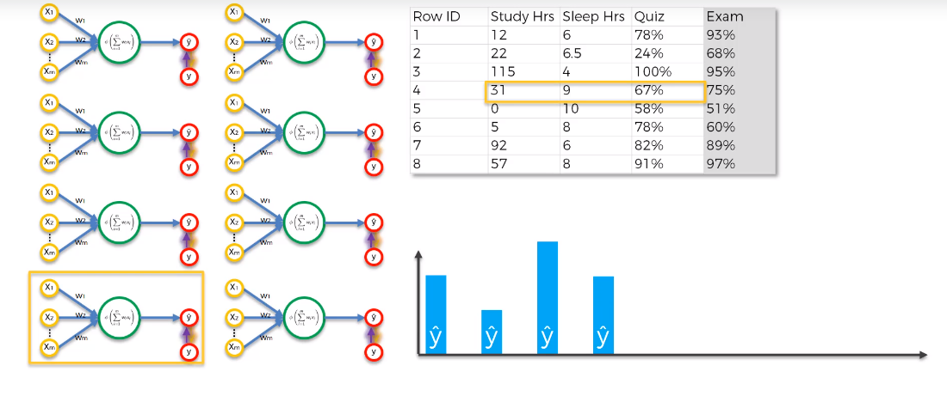
ANN – How do Neural Networks learn
DL

Slide 28
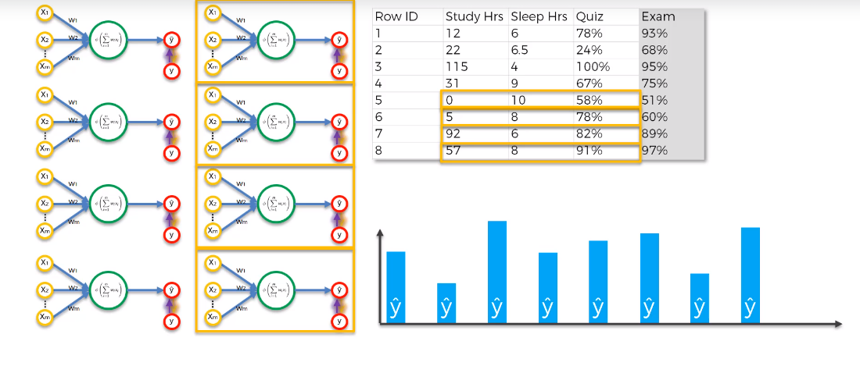
ANN – How do Neural Networks learn
DL

Slide 29
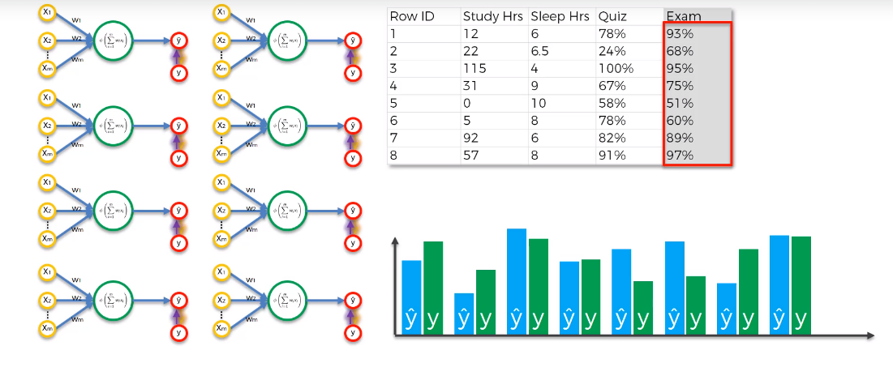
ANN – How do Neural Networks learn
DL

Slide 30
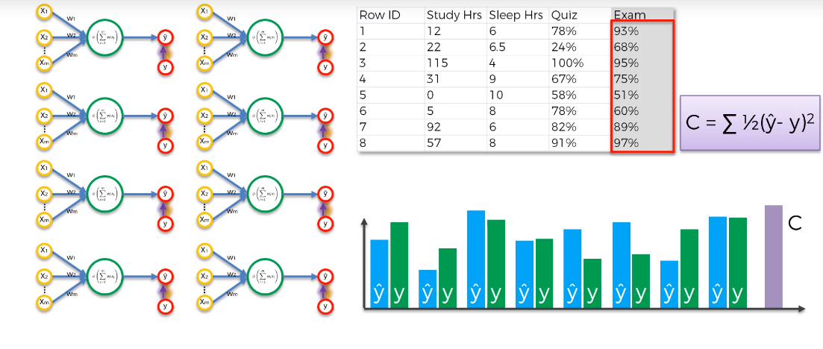
ANN – How do Neural Networks learn
DL

Slide 31
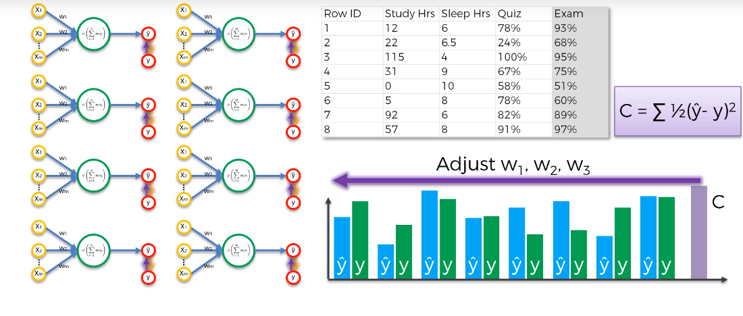
ANN – How do Neural Networks learn
This is 1st iteration. In DL we perform multiple iteration (commonly called EPOCH).

Slide 32

ANN – How do Neural Networks learn
Goal is to lower the cost function

Slide 33
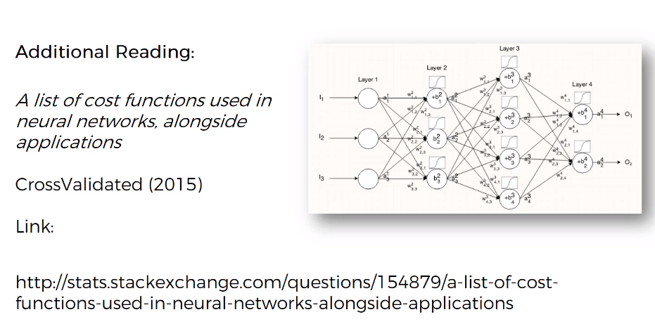
ANN – How do Neural Networks learn
https://stats.stackexchange.com/questions/154879/a-list-of-cost-functions-used-in-neural-networks-alongside-applications

